Slide 1
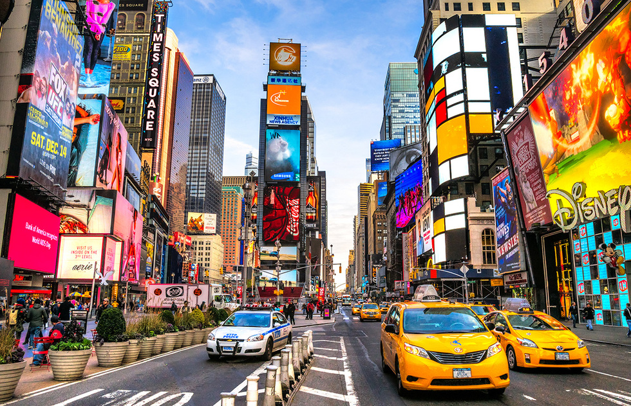

Slide 2
New York City
City of Light

